Slide 1

What to Know Before Investing in a Taxi Company
Arhum Ahmad

Slide 2
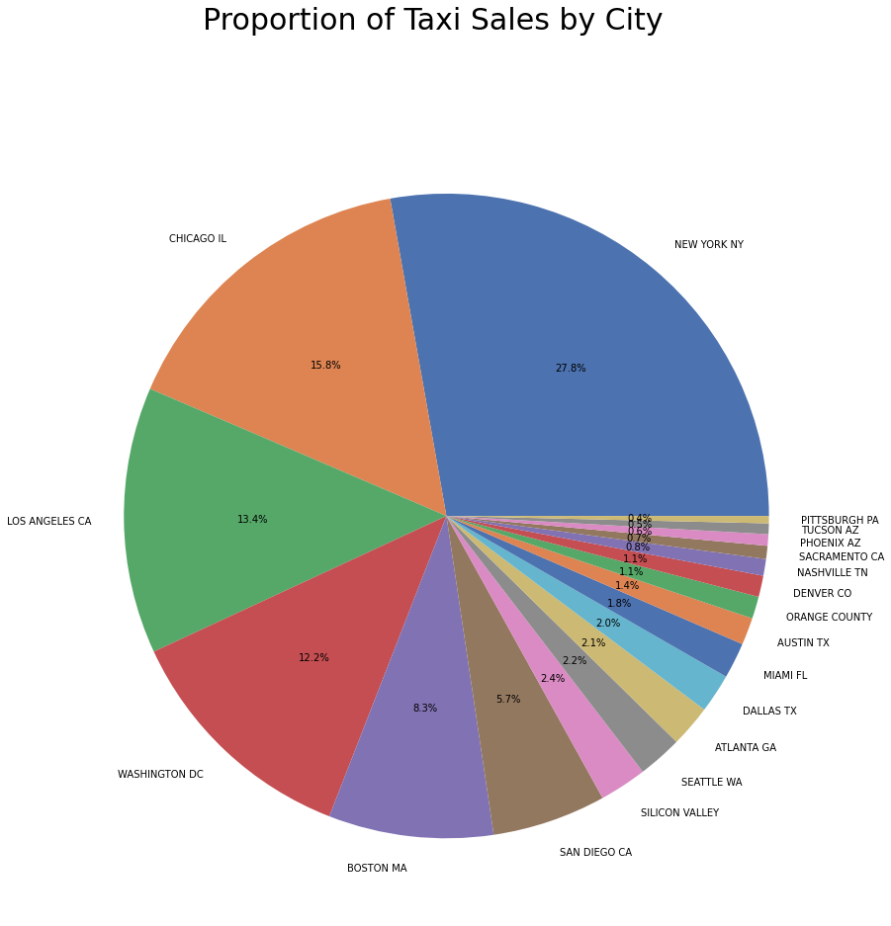
Who Uses Taxis?
57% of all taxi transactions are in New York City, Chicago, and Los Angeles
The three most populous cities in the US

Slide 3
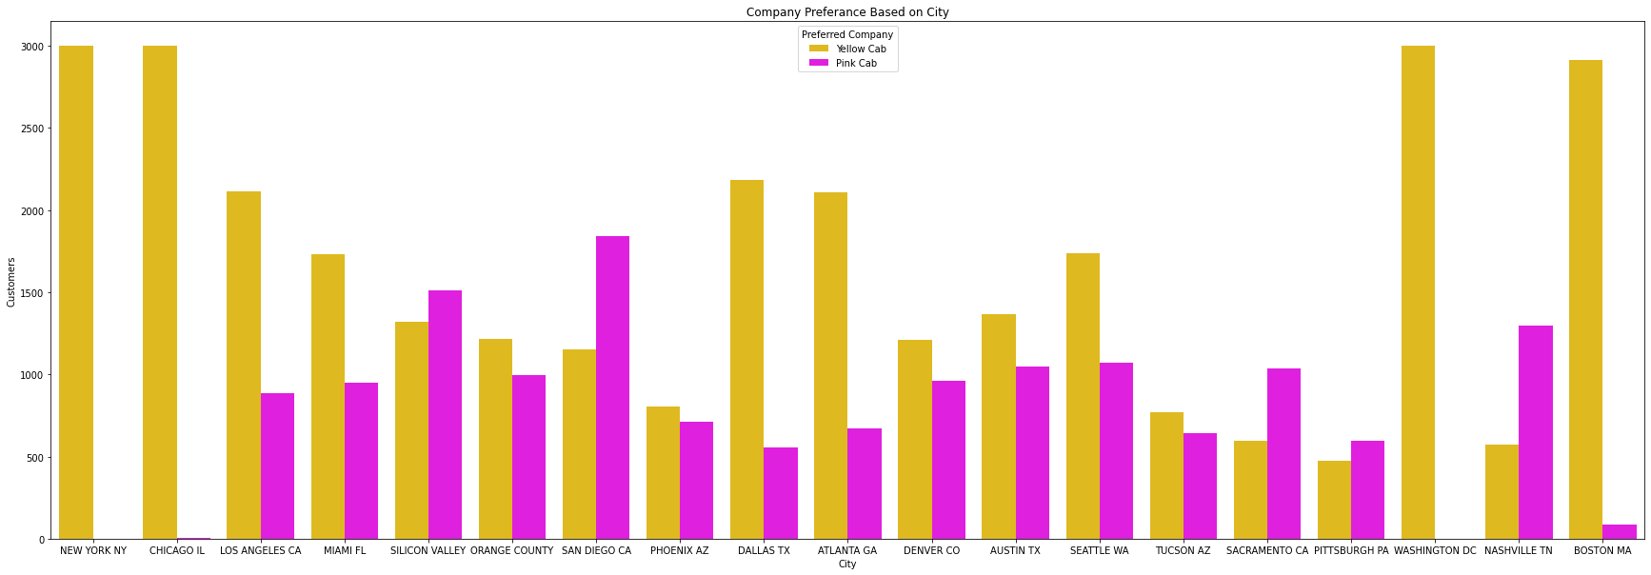
Who Uses Taxis?
NYC does not have a monopoly on total customer share compared to other cities despite being responsible for such a large portion of total Taxi transactions
Yellow Cab is more popular in most cities

Slide 4
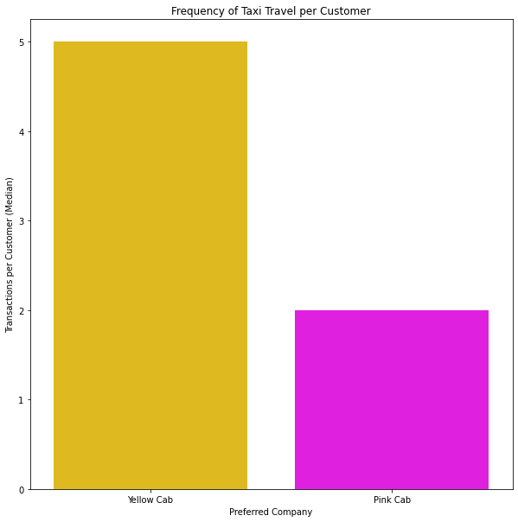
Who Uses Taxis?
Customers with a preference for Yellow Cab tend to use taxis more often than customers with a preference for Pink Cab
NYC, Chicago, LA, Washington DC, and Boston all have heavy preference towards Yellow Cab
These cities accounted for 77.5% of total taxi use between 2016-2018

Slide 5
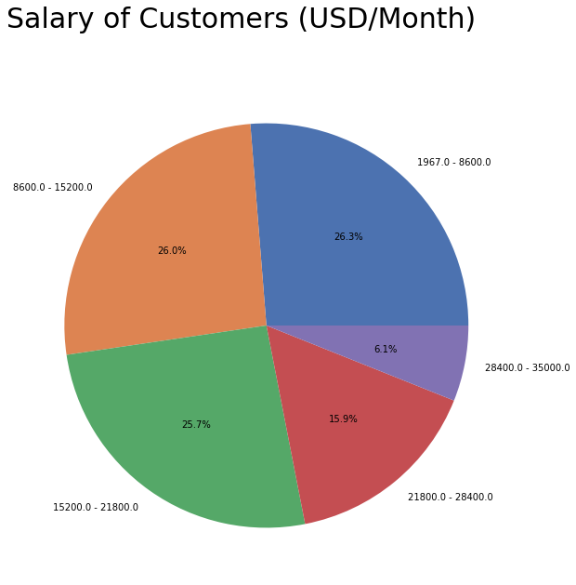
Who Uses Taxis?
These proportions are consistent throughout each city
No correlation found between salary and how often a customer uses taxis

Slide 6
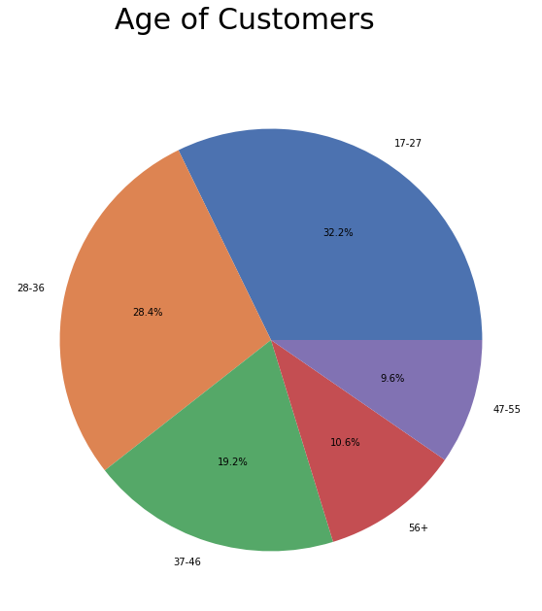
Who Uses Taxis?
Proportions are consistent between cities
No correlation found between age and how often a customer uses taxis

Slide 7
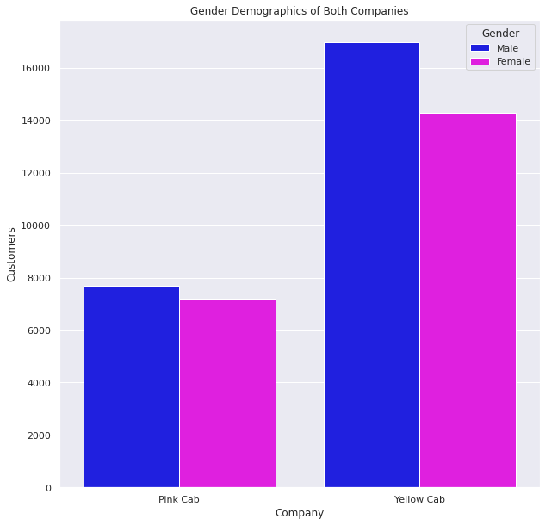
Who Uses Taxis?
Taxis have slightly more male customers than female
Both genders prefer Yellow Cab over Pink Cab

Slide 8
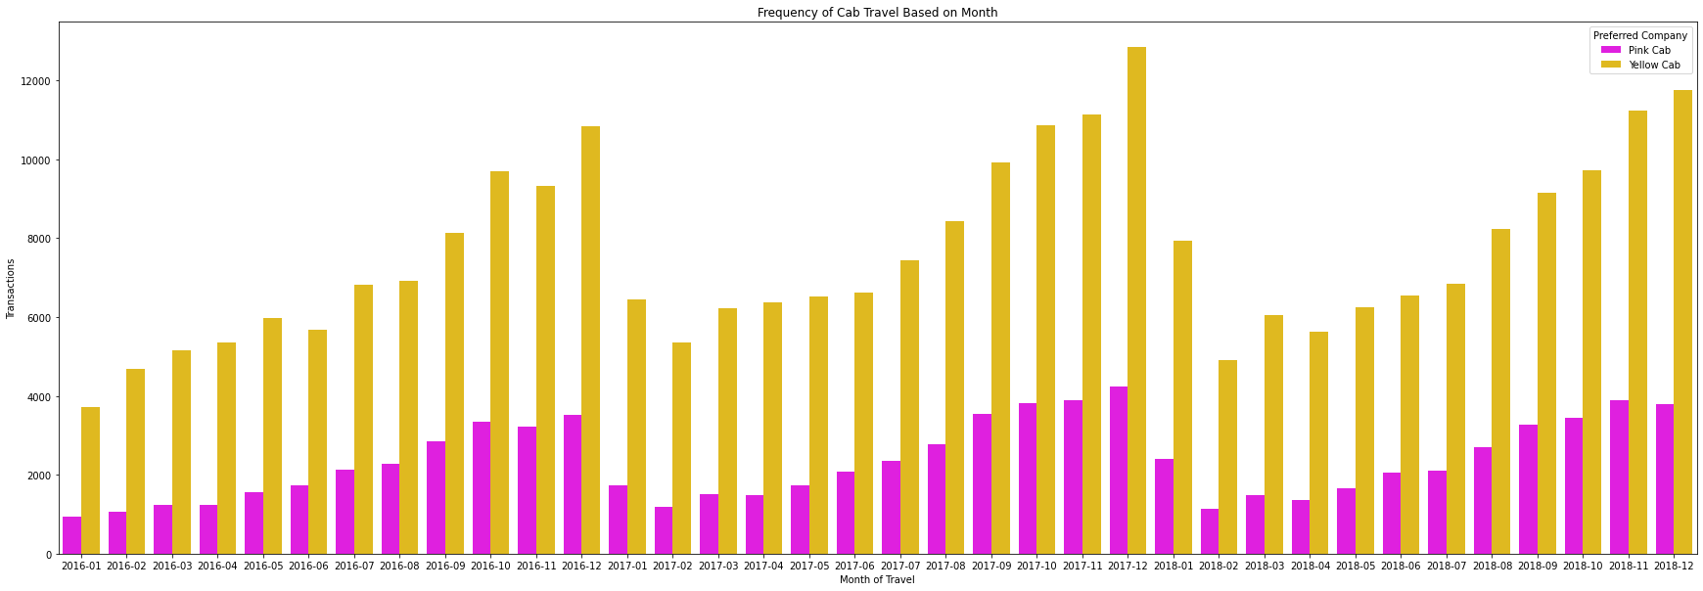
When Do People Use Taxis?

Slide 9

When Do People Use Taxis?
Cab usage regularly goes up throughout the year and then resets again in January
Possible reasons
Most of the cab usage is in colder cities where the whether may encourage more people to use taxis
Major growth in taxi usage usually starts in September which is when school reopens for many people
Holidays could cause an increase in taxi usage including going out to buy presents
The reset in January could be caused by New Years resolutions which are shortly broken
Forbes reports that 80% of New Years resolutions are broken in February (Murphy, 2020)
February had the lowest taxi usage in both 2017 and 2018 before bouncing back up

Slide 10
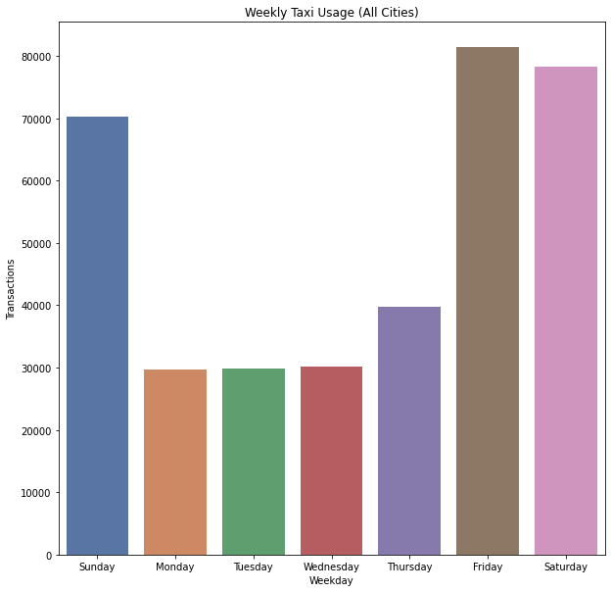
When Do People Use Taxis?
There is an increase in taxi usage on weekends
This indicates that night life is a major source of revenue for the industry
Alcohol is likely a reason for this figure

Slide 11
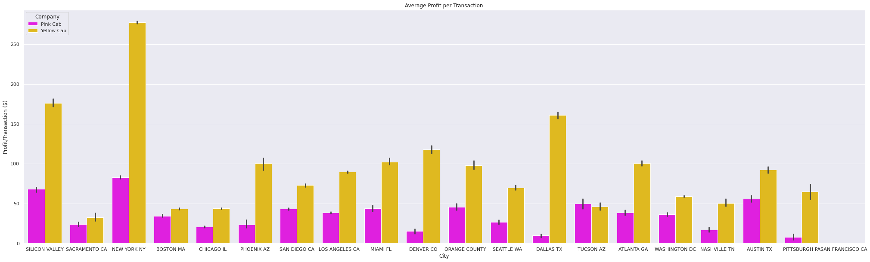
Where is the Best Market for Taxis?

Slide 12
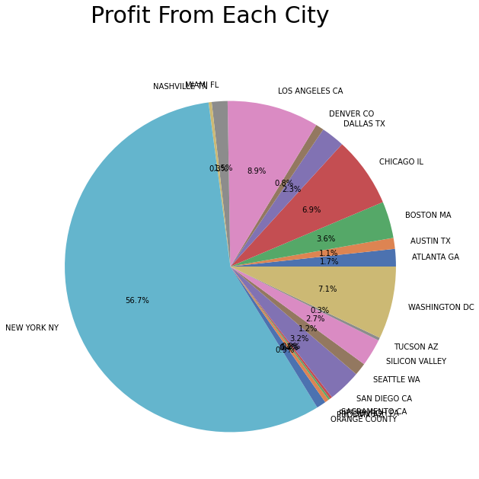
Where is the Best Market for Taxis?
New Yorkers are willing to spend more
Yellow Cab makes up almost all of this profit
They also use taxis the most often
New York City is by far the most profitable market for taxis

Slide 13
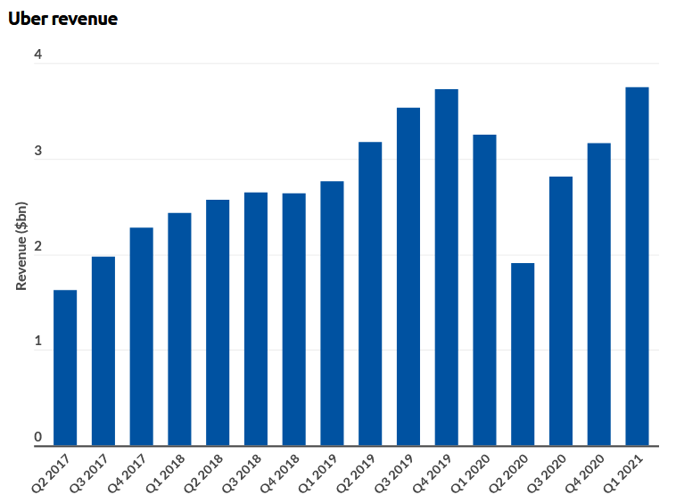
The Biggest Threat to Taxis: Uber (and other ride sharing services)
Uber has been consistently growing its revenue every quarter (Iqbal, 2021)
Already back to pre pandemic numbers
Uber/Lyft wait times are significantly shorter than taxi wait times (Huet, 2014)
Especially true in areas where you cannot hail a taxi from the sidewalk
Significantly cheaper for long trips (Picchi, 2016)
Not always true for shorter trips which are popular in cities like New York

Slide 14

How Can Taxis Survive in a World with Uber?

Slide 15

Following Nintendo’s Example
In the early 2000s Nintendo could no longer compete with Sony, Microsoft, and Valve
Solution: Stop Competing
Nintendo carved out its own market and now people buy a Nintendo system in addition to their primary system
Admitted defeat in order to survive and thrive

Slide 16
How Taxis Can Adapt
It is impossible for taxis to compete with ride sharing in suburbs
Zero way to replicate convenience and price
Focus all resources on urban areas (ie NYC)
Admit defeat and carve out unique urban market in which taxis can thrive on shorter trips

Slide 17
Should You Invest in the Taxi Industry?
Ride Sharing Services are much more profitable than taxis in the long run and would be the better investment
Between the two taxi companies, Yellow Cab is the much better option for investment
With a majority share of Yellow Cab shares, the firm could influence the company to downsize and focus on urban areas
Focus on maximizing profit in cities such as New York and Chicago and beating all competition there
The best time to invest for short term profit is January

Slide 18
Bibliography
Murphy, Mark. “This Is The Month When New Year’s Resolutions Fail- Here’s How To Save Them”. Forbes, February 11, 2020. https://www.forbes.com/sites/markmurphy/2020/02/11/this-is-the-month-when-new-years-resolutions-fail-heres-how-to-save-them/?sh=632e1175272f.
Iqbal, Mansoor. “Uber Revenue and Usage Statistics (2021)”. Business of Apps, May 15, 2021. https://www.businessofapps.com/data/uber-statistics/
Huet, Ellen. “Uber, Lyft Cars Arrive Much Faster Than Taxis, Study Says”. Forbes, September 8, 2014. https://www.forbes.com/sites/ellenhuet/2014/09/08/uber-lyft-cars-arrive-faster-than-taxis/?sh=17c99631f2cb
Picchi, Aimee. “Uber vs. Taxi: Which Is Cheaper?”. Consumer Reports, June 10, 2016. https://www.consumerreports.org/personal-finance/uber-vs-taxi-which-is-cheaper/

Slide 19
Your best quote that reflects your approach… “It’s one small step for man, one giant leap for mankind.”
- Neil Armstrong

